Slide 1
Modelling the expansion of the universe.
Investigating the redshift of type Ia supernovae through spectroscopic datasets.

Slide 2
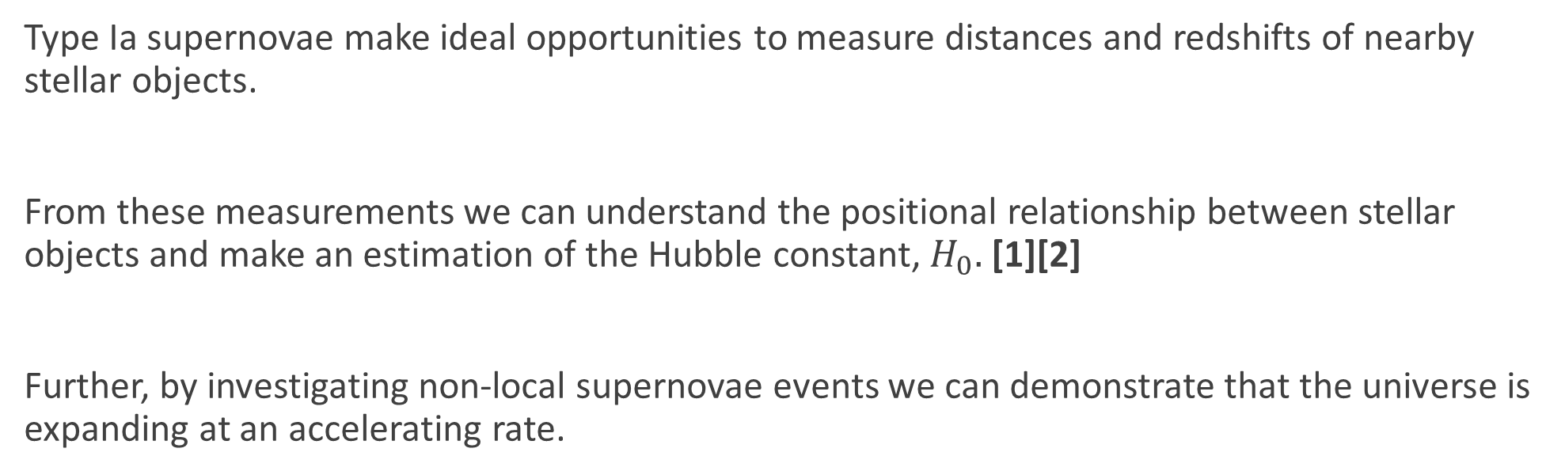
Motivation
Type Ia supernovae make ideal opportunities to measure distances and redshifts of nearby stellar objects.
From these measurements we can understand the positional relationship between stellar objects and make an estimation of the Hubble constant, $H_{0}.$ [1][2]
Further, by investigating non-local supernovae events we can demonstrate that the universe is expanding at an accelerating rate.
[1] A 2.4% DETERMINATION OF THE LOCAL VALUE OF THE HUBBLE CONSTANT, Reiss et. al 2016.
[2] The effects of peculiar velocities in SN Ia environments on the local H₀ measurement, T. Sedgwick et. al 2020

Slide 3

Theoretical background
For the type Ia classified supernovae under investigation, we can determine their distance, d using the apparent and absolute magnitudes, m and M:
We will consider three models for the distance to these planets in terms of their redshift, z. Firstly the simple Hubble equation:
$m −M=5log⁡(d)$ – 5 | Equation (1)
$$d= \frac{cz}{H_{0}}$$ | Equation (2)

Slide 4
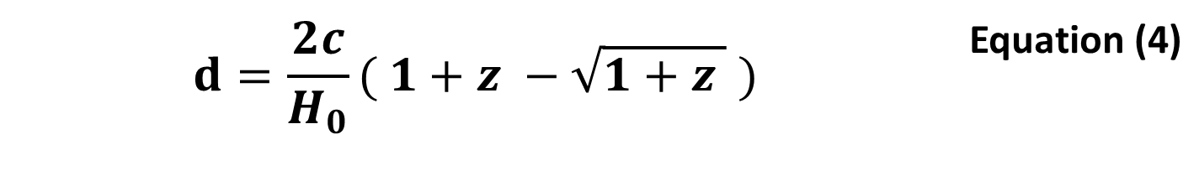

Theoretical background
The second model is the massless universe
The third model under consideration is the matter dominant universe modelled by the following
$$d=\frac{cz}{H_{0}}( 1+\frac{z}{2} )$$ | Equation (3)
$$d=\frac{2c}{H_{0}}( 1+z −\sqrt{1+z } )$$ | Equation (4)

Slide 5

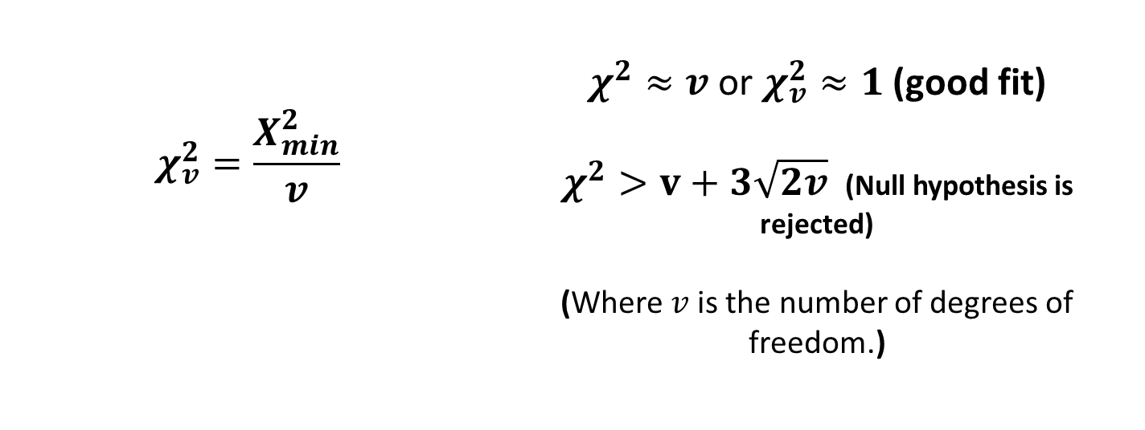
Theoretical background
We will derive the Hubble constant from an iterative process using python to perform a least squares fit, given by:
$$χ^{2}=\sum_{i}{\frac{{\left(O_{i}−E_{i}\right)}^{2}}{σ_{i}^{2}}}$$ | Equation (5)
$$χ_{v}^{2}=\frac{X_{min}^{2}}{v}$$ | $χ^{2}≈v$ or $χ_{v}^{2}≈1$ (good fit) $χ^{2}>v+3\sqrt{2v}$ (Null hypothesis is rejected) (Where $v$is the number of degrees of freedom.)

Slide 6
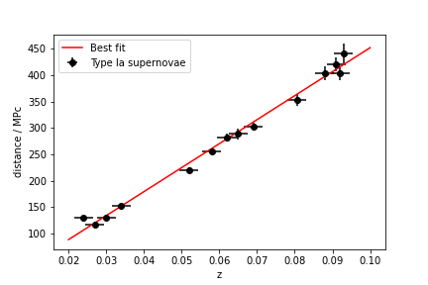
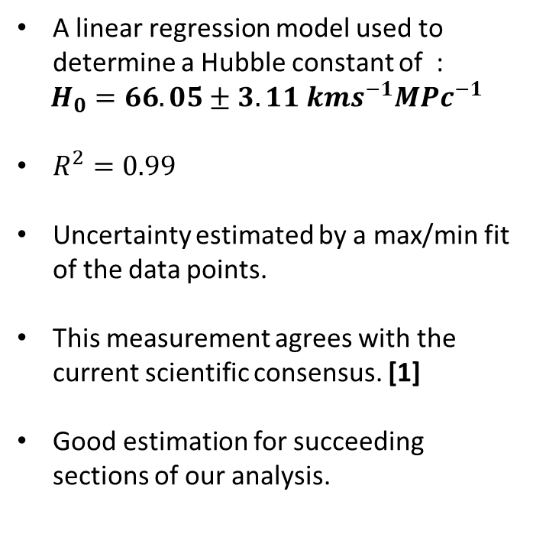
Determination of the Hubble constant
A linear regression model used to determine a Hubble constant of :
$$H_{0}=66.05±3.11 kms^{−1}MPc^{−1}$$
$R^{2}=0.99$
Uncertainty estimated by a max/min fit of the data points.
This measurement agrees with the current scientific consensus. [1]
Good estimation for succeeding sections of our analysis.
Figure 1 – Redshift versus distance from our low redshift dataset.

Slide 7
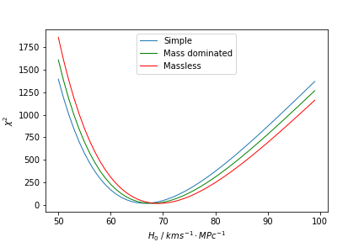
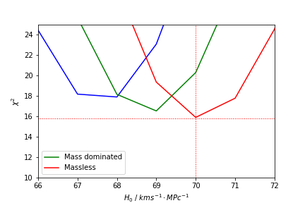
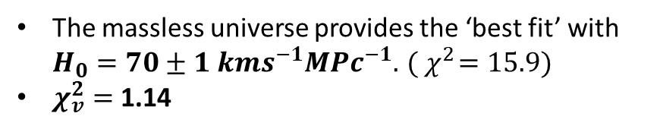
Modelling the low redshift region
Figure 2(b) – ‘Zoomed in’ image of the minima from figure 2(a)
The massless universe provides the ‘best fit’ with $H_{0}=70±1 kms^{−1}MPc^{−1}. { ( χ}^{2}=15.9)$
$χ_{v}^{2}=$1.14
Figure 2(a) – Iterations over each model using python.

Slide 8
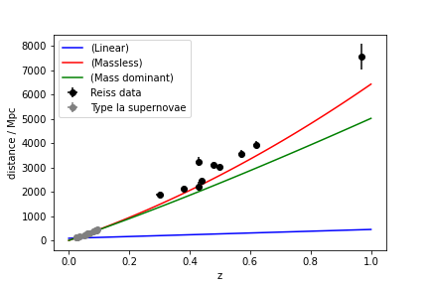
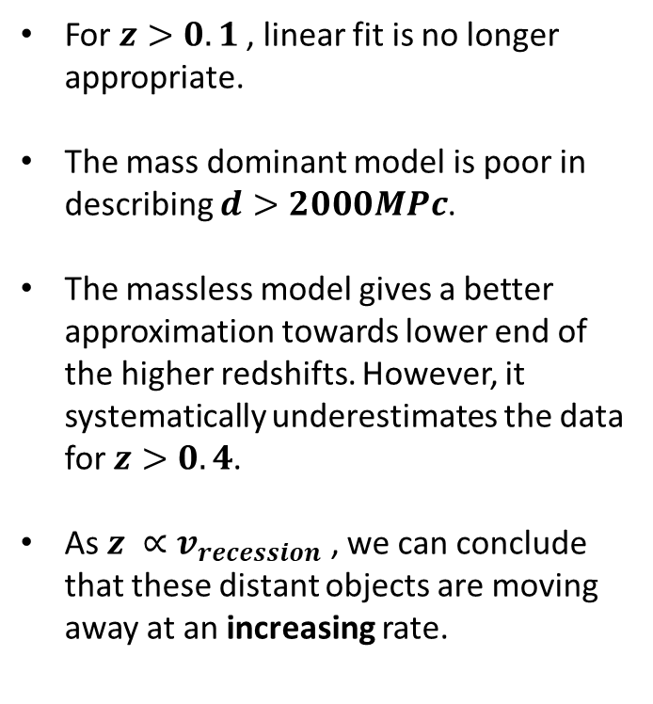
Modelling the high redshift regime
For $z>0.1$, linear fit is no longer appropriate.
The mass dominant model is poor in describing $d>2000MPc$.
The massless model gives a better approximation towards lower end of the higher redshifts. However, it systematically underestimates the data for $z>0.4$.
As $z ∝v_{recession}$ , we can conclude that these distant objects are moving away at an increasing rate.
Figure 3 – The Reiss data plotted with the theoretical models described in equation 2, 3, 4 .

Slide 9
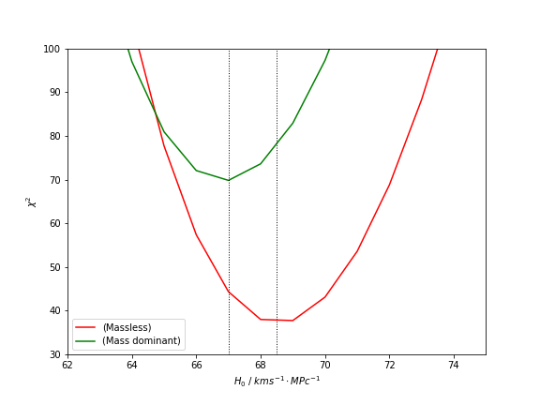
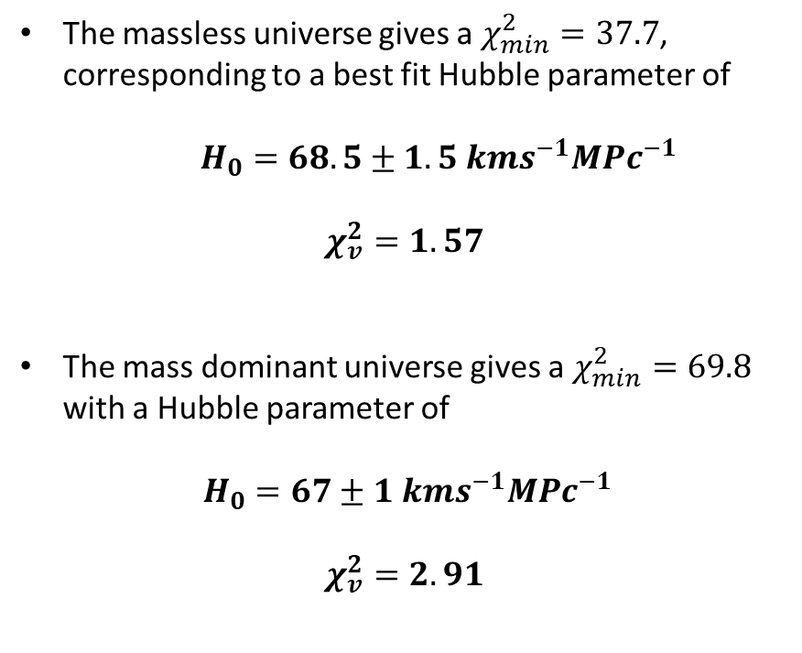
The massless universe gives a $χ_{min}^{2}=37.7$, corresponding to a best fit Hubble parameter of
$H_{0}=68.5±1.5 kms^{−1}MPc^{−1}$
$$χ_{v}^{2}=1.57$$
The mass dominant universe gives a $χ_{min}^{2}=69.8$ with a Hubble parameter of
$H_{0}=67±1 kms^{−1}MPc^{−1}$
$$χ_{v}^{2}=2.91$$
Figure 4 – Comparison on $χ^{2}$ for iterations of potential Hubble constants

Slide 10
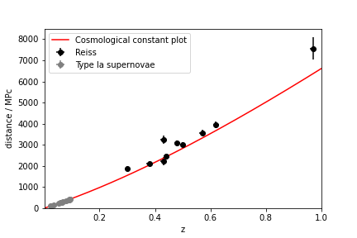
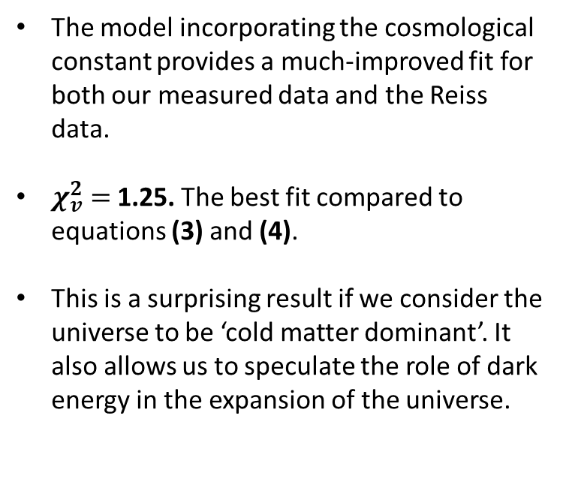
Matter and dark energy dominated universe
The model incorporating the cosmological constant provides a much-improved fit for both our measured data and the Reiss data.
$χ_{v}^{2}$ $=$1.25. The best fit compared to equations (3) and (4).
This is a surprising result if we consider the universe to be ‘cold matter dominant’. It also allows us to speculate the role of dark energy in the expansion of the universe.
Figure 5 – The Reiss and measured data plotted against the theoretical model including the cosmological constant.

Slide 11
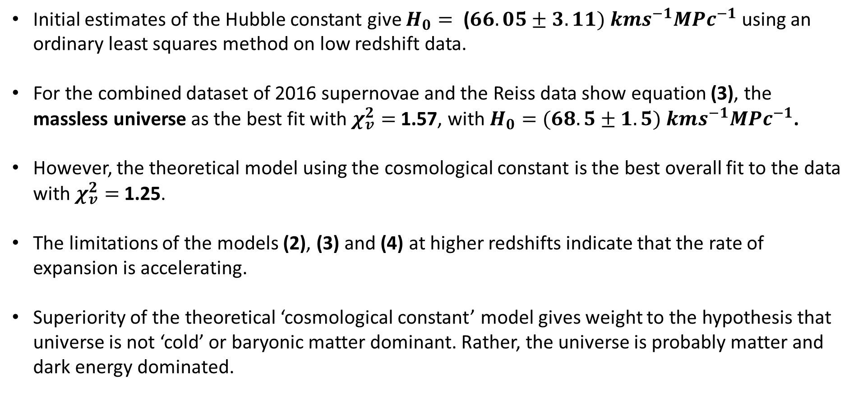
Summary
Initial estimates of the Hubble constant give $H_{0}= \text{(}66.05±3.11) kms^{−1}MPc^{−1}$ using an ordinary least squares method on low redshift data.
For the combined dataset of 2016 supernovae and the Reiss data show equation (3), the massless universe as the best fit with $χ_{v}^{2}=$1.57, with $H_{0}=(68.5±1.5) kms^{−1}MPc^{−1}$.
However, the theoretical model using the cosmological constant is the best overall fit to the data with $χ_{v}^{2}=$1.25.
The limitations of the models (2), (3) and (4) at higher redshifts indicate that the rate of expansion is accelerating.
Superiority of the theoretical ‘cosmological constant’ model gives weight to the hypothesis that universe is not ‘cold’ or baryonic matter dominant. Rather, the universe is probably matter and dark energy dominated.

